Slide 1
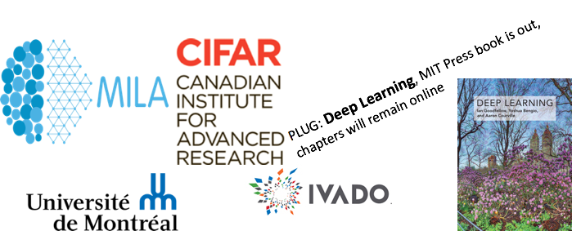
Deep Learning for AI
Yoshua Bengio
June 12th, 2018
SEMLA 2018, Montréal

Slide 2
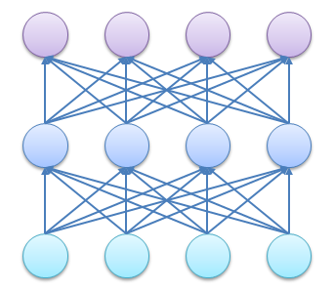
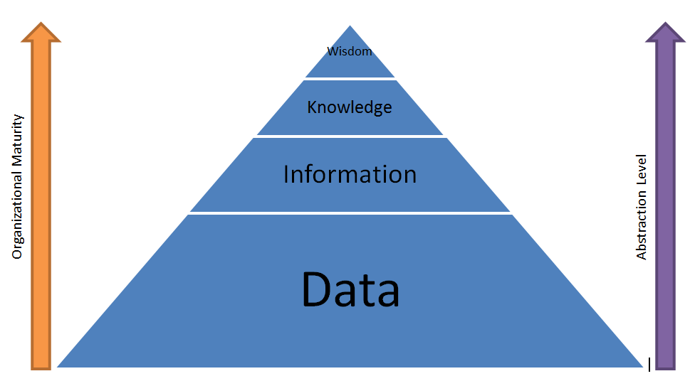

Learning Multiple Levels of Abstraction
(Bengio & LeCun 2007)
The big payoff of deep learning is to allow learning higher levels of abstraction
Higher-level abstractions disentangle the factors of variation, which allows much easier generalization and transfer

Slide 3
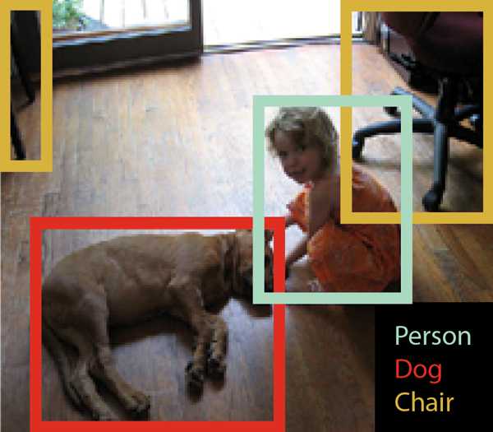
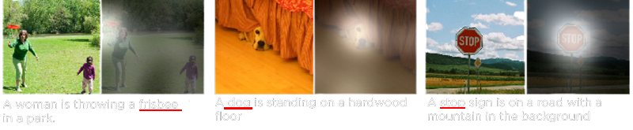
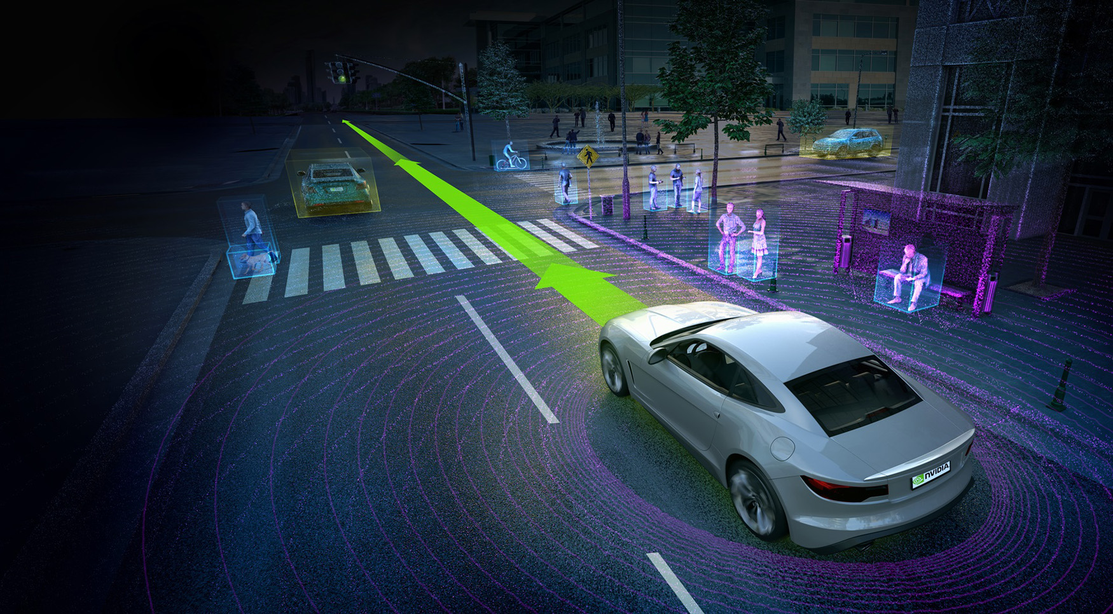
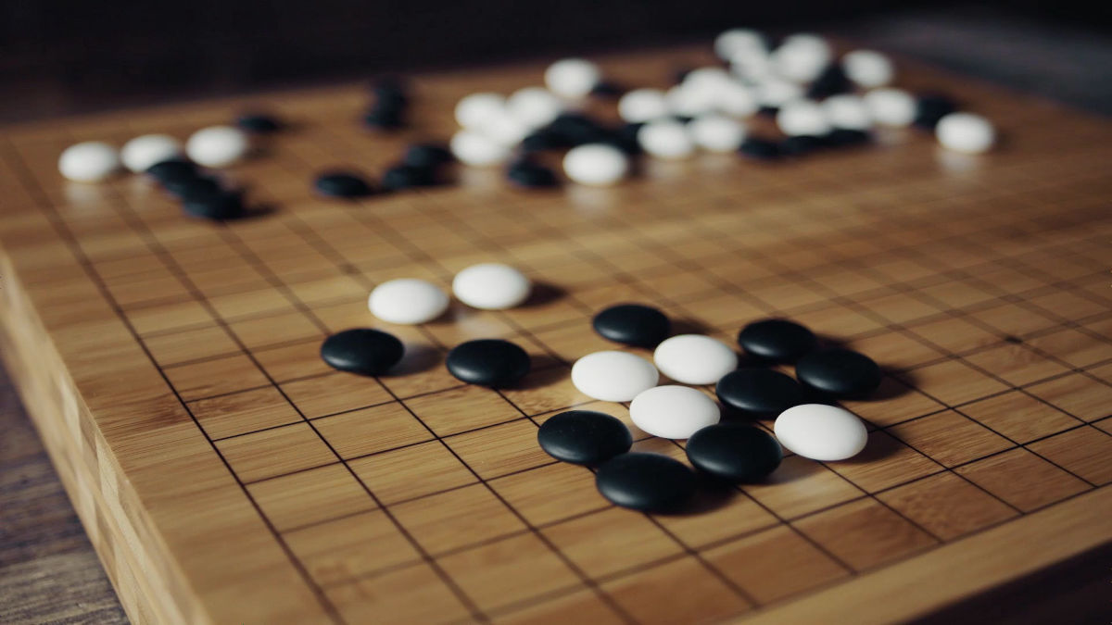

Deep Learning AI Breakthroughs
Computers have made huge strides in perception, manipulating language, playing games, reasoning, ...

Slide 4

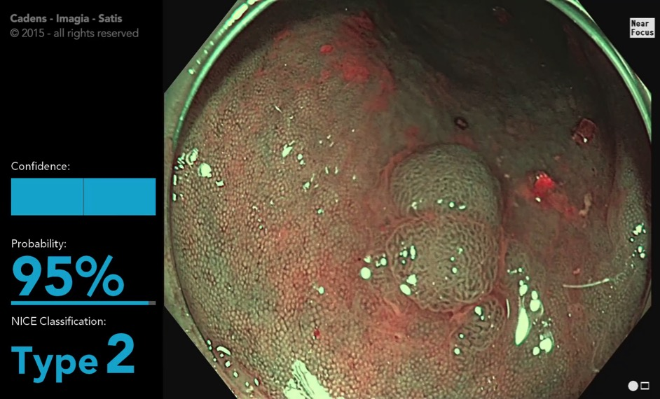
Medical Image Classification
@ Montreal
Detect cancer cells by deep learning
Accuracy
Imagia | > 90%, real time
GI Experts (Key Opinion Leaders)* | ~ 90%
GI Doctors Trained by KOLs* | ~ 75%
*(D. Rex, 2015)
Notes:
Advances in Colonoscopy, An Issue of Gastrointestinal Endoscopy Clinics
Doug rex 2015

Slide 5
Separately Controlling Style & Content
GAN: Adversarial generative framework between D and G
Goal: generate from samples from noise, z, transformed by a function G, such that pg(x) is close (equal) to a target distribution pd(x).
Introduce a discriminator D
(Original) D maximizes the value function (min-max game):
At the optimal discriminator (maximizing V), minimizing V amounts to minimizing JSD between pg(x) and pd(x).
Train purely through back-prop
Produces highly realistic data compared to MLE methods
Does not work naturally with discrete data
[à la Zhu et. al., 2017]
Input
Target style
Output
[Luan et. al., 2017]
Notes:
Topic:
BGAN
GANs don’t work with discrete data
Notes:
-> GANs for discrete data
REINFORCE-based methods do not work well
What are GANs
advances, ALI, style transfer,
Backprop

Slide 6
Filling in the Details: Super-Resolution
GAN: Adversarial generative framework between D and G
Goal: generate from samples from noise, z, transformed by a function G, such that pg(x) is close (equal) to a target distribution pd(x).
Introduce a discriminator D
(Original) D maximizes the value function (min-max game):
At the optimal discriminator (maximizing V), minimizing V amounts to minimizing JSD between pg(x) and pd(x).
Train purely through back-prop
Produces highly realistic data compared to MLE methods
Does not work naturally with discrete data
[Ledig et. al., 2016]
Low res
High res
Notes:
Topic:
BGAN
GANs don’t work with discrete data
Notes:
-> GANs for discrete data
REINFORCE-based methods do not work well
What are GANs
advances, ALI, style transfer,
Backprop

Slide 7
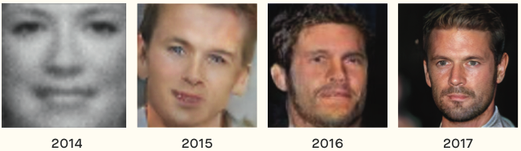
Creative Deep Learning:
Generative Adversarial Networks

Slide 8
Machine Learning, AI & No Free Lunch
Five key ingredients for ML towards AI
  Lots & lots of data
  Very flexible models
  Enough computing power
  Computationally efficient inference
  Powerful priors that can defeat the curse of dimensionality

Slide 9
Why does Deep Learning Work? Bypassing the curse of dimensionality
We need to build compositionality into our ML models
  Just as human languages exploit compositionality to give representations and meanings to complex ideas
Exploiting compositionality gives an exponential gain in representational power
  Distributed representations / embeddings: feature learning
  Deep architecture: multiple levels of feature learning
Prior assumption: compositionality is useful to describe the world around us efficiently
Notes:
You must do unsupervised learning from the sensory input

Slide 10
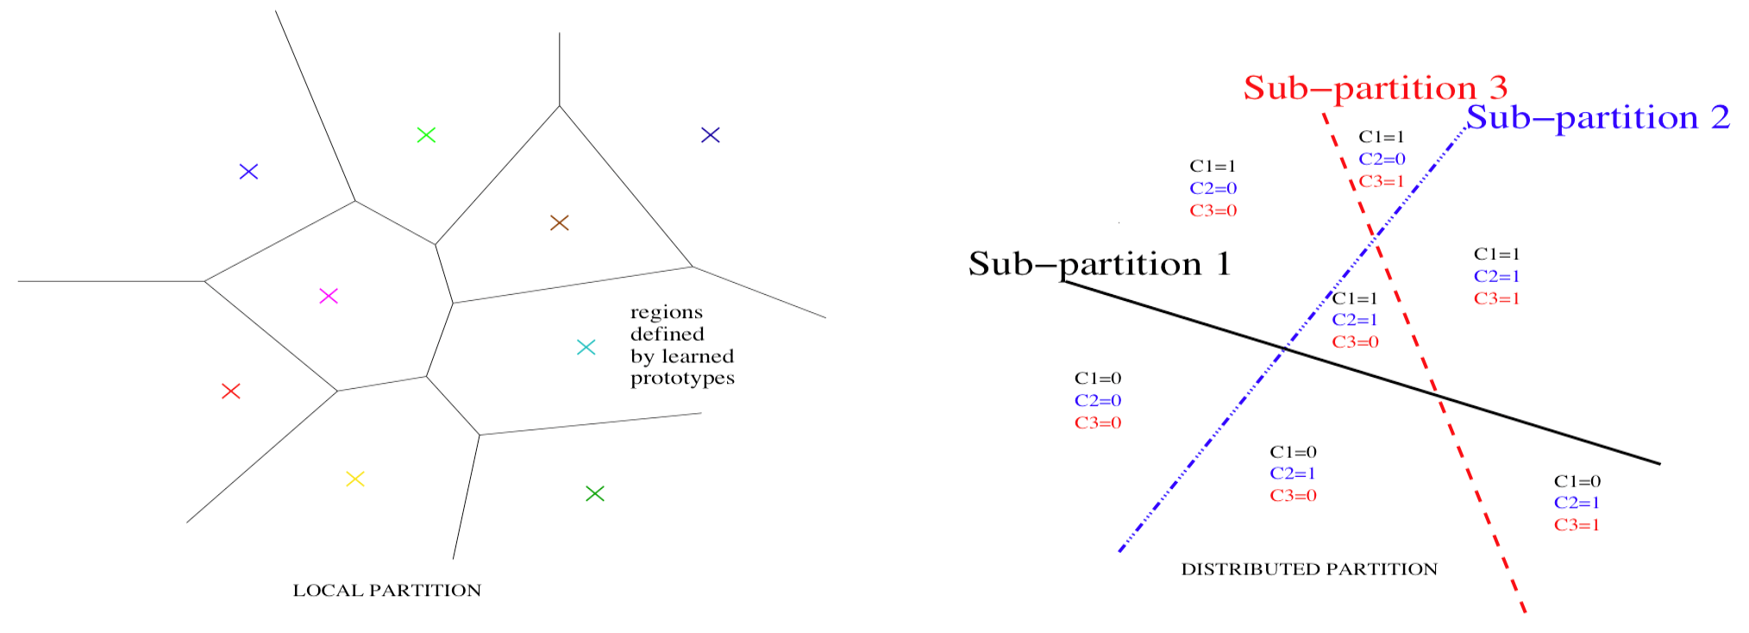
Distributed Representations: The Power of Compositionality – Part 1
Distributed (possibly sparse) representations, learned from data, can capture the meaning of the data and state
Parallel composition of features: can be exponentially advantageous
Not Distributed
Distributed

Slide 11
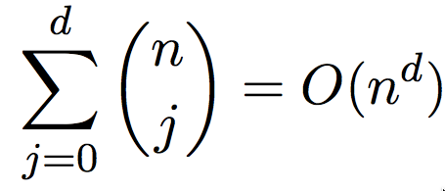
Exponential advantage of distributed representations
Bengio 2009 (Learning Deep Architectures for AI, F & T in ML)
Montufar & Morton 2014 (When does a mixture of products contain a product of mixtures? SIAM J. Discr. Math)
Longer discussion and relations to the notion of priors: Deep Learning, 2016, MIT Press.
Prop. 2 of Pascanu, Montufar & Bengio ICLR’2014: number of pieces distinguished by 1-hidden-layer rectifier net with n units and d inputs (i.e. O(nd) parameters) is

Slide 12

Deep Representations: The Power of Compositionality – Part 2
Learned function seen as a composition of simpler operations, e.g. inspired by neural computation
Hierarchy of features, concepts, leading to more abstract factors enabling better generalization
Again, theory shows this can be exponentially advantageous
Why multiple layers? The world is compositional

Slide 13
Theoretical result: Expressiveness of deep nets with piecewise-linear activation fns
(Pascanu, Montufar, Cho & Bengio; ICLR 2014)
(Montufar, Pascanu, Cho & Bengio; NIPS 2014)
Deeper nets with rectifier/maxout units are exponentially more expressive than shallow ones (1 hidden layer) because they can split the input space in many more (not-independent) linear regions, with constraints, e.g., with abs units, each unit creates mirror responses, folding the input space:

Slide 14
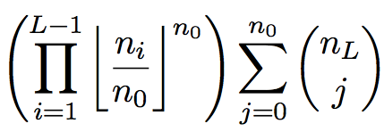
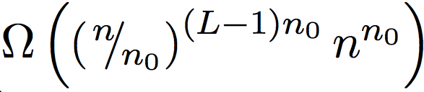
Exponential advantage of depth
Expressiveness of deep networks with piecewise linear activation functions: exponential advantage for depth
(Montufar et al & Bengio, NIPS 2014)
Number of pieces distinguished for a network with depth L and n_{i} units per layer is at least
or, if hidden layers have width n and input has size n₀

Slide 15
Latent Variables and Abstract Representations to Disentangle Manifolds
P(h)
Encoder/decoder view: maps between low & high-levels
Encoder does inference: interpret the data at the abstract level
Decoder can generate new configurations
Encoder flattens and disentangles the data manifold
Q(h|x)
Abstract
representation
space
encoder
decoder P(x|h)
data space

Slide 16
Why Generative Models with a Latent Space?
GAN: Adversarial generative framework between D and G
Goal: generate from samples from noise, z, transformed by a function G, such that pg(x) is close (equal) to a target distribution pd(x).
Introduce a discriminator D
(Original) D maximizes the value function (min-max game):
At the optimal discriminator (maximizing V), minimizing V amounts to minimizing JSD between pg(x) and pd(x).
Train purely through back-prop
Produces highly realistic data compared to MLE methods
Does not work naturally with discrete data
“What I cannot create, I do not understand”
-Richard Feynman
Generation
Age
Inference
c
Gender
Interpolation
Notes:
Topic:
BGAN
GANs don’t work with discrete data
Notes:
-> GANs for discrete data
REINFORCE-based methods do not work well
What are GANs
advances, ALI, style transfer,
Backprop

Slide 17
Maps Between Representations
x and y represent different modalities, e.g., image, text, sound…
Can provide 0-shot generalization to new categories (values of y)
(Larochelle et al AAAI 2008)

Slide 18
The Attention Revolution in Deep Learning
Attention mechanisms exploit GATING units, have unlocked a breakthrough in machine translation:
    Neural Machine Translation
Now in Google Translate:
(ICLR’2015)
Higher-level
Softmax over lower
locations conditioned
on context at lower and
higher locations
Lower-level
current
neural net
translation
n-gram
translation
human
translation
Human
evaluation

Slide 19
Conditional Computation
Change the form of the computation (and which neurons are activated) based on some conditioning variables (Bengio et al 2013, arXiv:1308.3432)
Gating units select which blocks
are to be activated, given the
conditioning variables (as in the
mixture of experts)

Slide 20
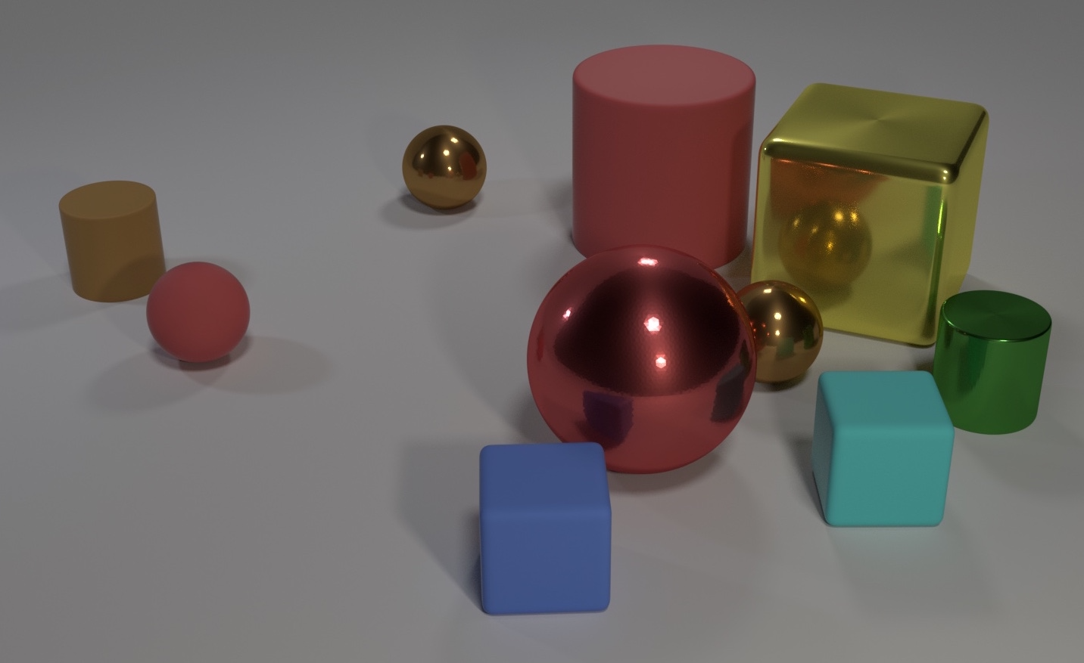
FiLM: Feature-Wise Linear Modulation
Conditioned gaters modulate each ReLU feature map, leading to SOTA on the CLEVR task
Are there an equal number of large things and metal spheres?

Slide 21
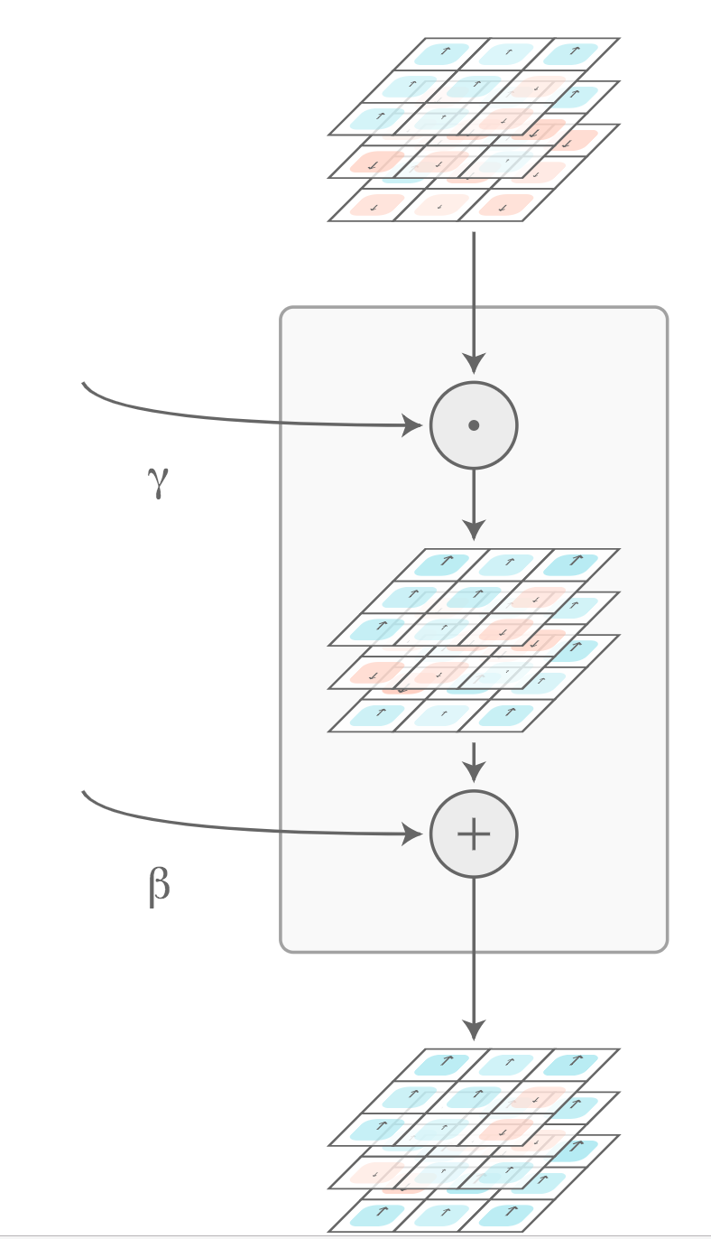

FiLM architectures
One additive and one multiplicative scalar per unit, as output of the gating network, controlling the computation done in each feature map

Slide 22
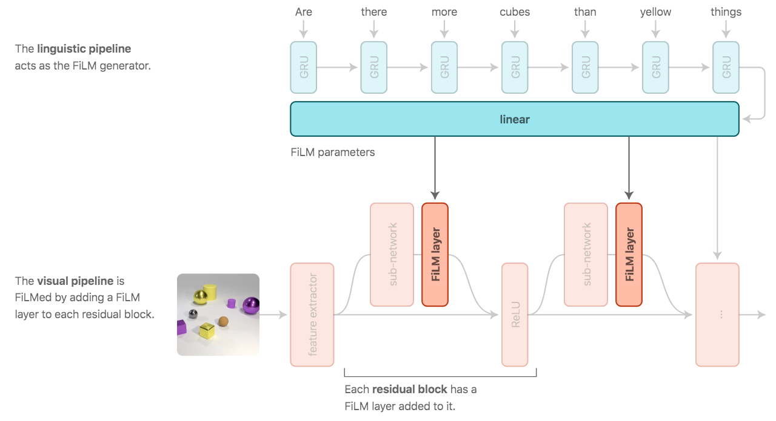
FiLM for Question-Answering
(Perez et al, AAAI 2018)

Slide 23
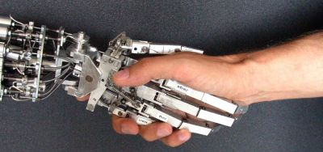
The Future of Deep AI
Scientific progress is slow and continuous, but social and economic impact can be disruptive
Many fundamental research questions are in front of us, with much uncertainty about when we will crack them, but we will
Importance of continued investment in basic & exploratory AI research, for both practical (recruitment) short-term and long-term reasons
Let us continue to keep the field open and fluid, be mindful of social impacts, and make sure AI will bloom for the benefit of all

Slide 24
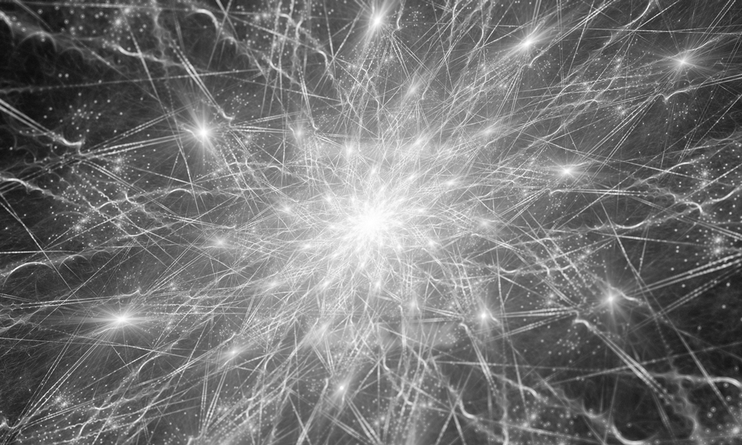
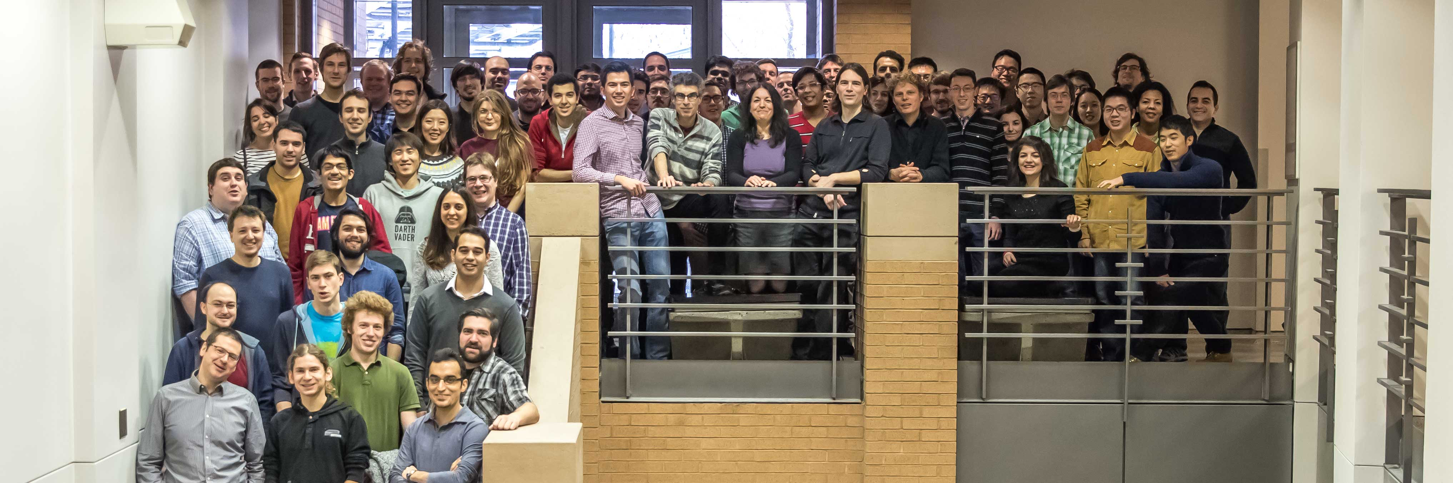


Montreal Institute for Learning Algorithms

